Slide 1
Manufacturing Data Collection and Analytics
Option №3
Graduate School of Business
Business Informatics
Moscow, 2023
Prepared by:
Sokolova Anna
Petrash Kirill
Abdallah Maryanna
Golubeva Alina

Slide 2
Content/Task division:
Create VM and DB (Anna)
Create DB structure (Anna)
Python Script for parsing and loading data (Anna)
Data preparation (Alina, Maryanna)
Node-red MQTT Dashboard (Alina)
Analysis in Python (Maryanna)
Analysis in Excel (Alina, Maryanna)
Create a Telegram bot(Kirill)
Make notifications about errors and extreme values from sensors(Kirill)

Slide 3
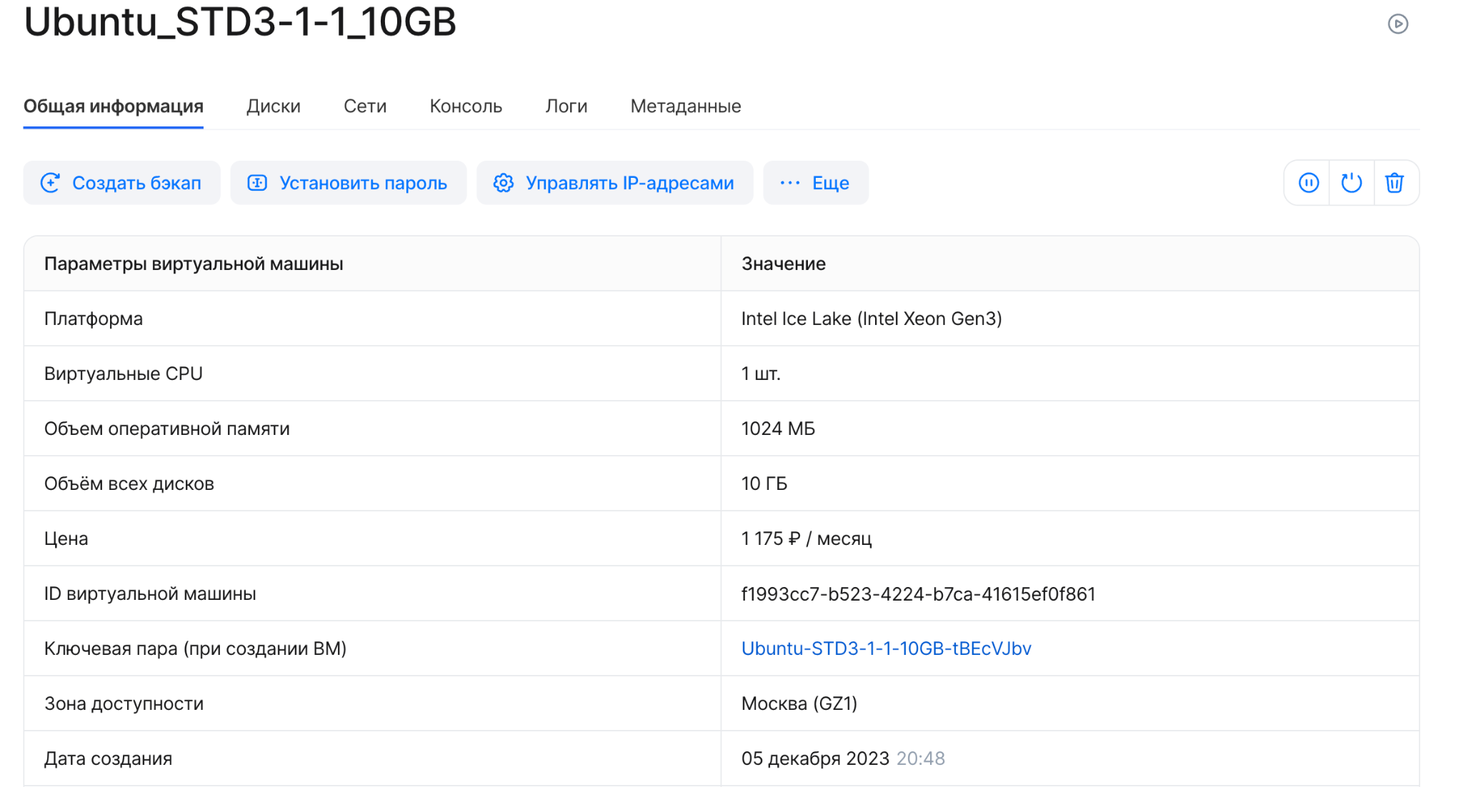
First step
“create VM on the VK cloud”:
Configure the required settings
Connect to the VM (via SSH key)

Slide 4
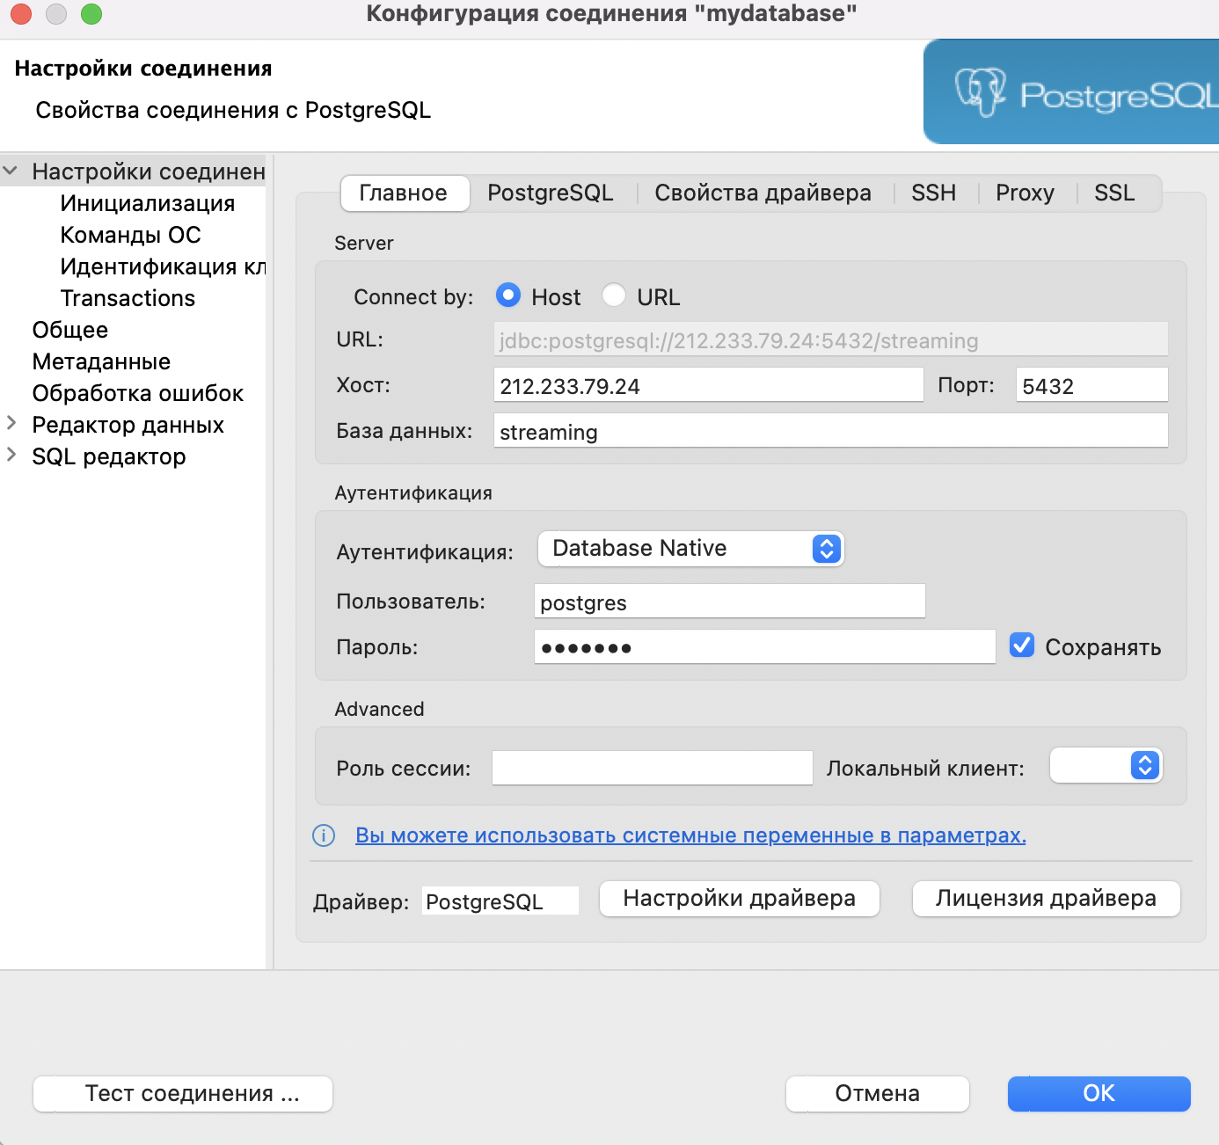
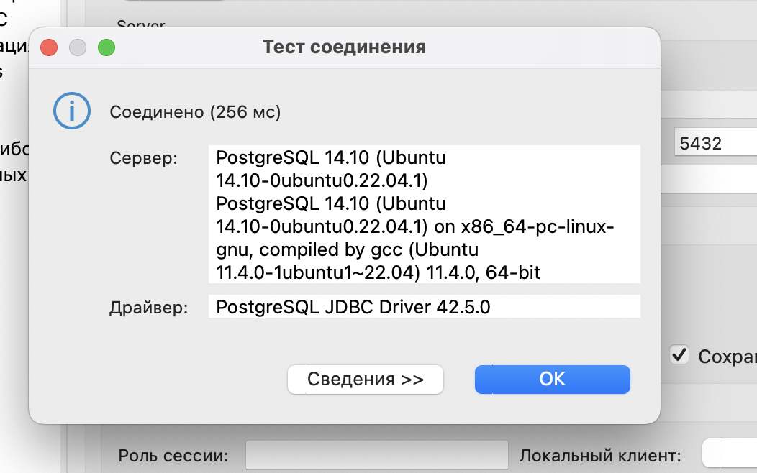
Second step
“create DB”:
Start the database service
Configure the database
Create a database
Create a user and give it all permissions
Configure remote access to the database
Check availability

Slide 5
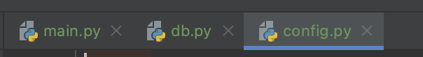
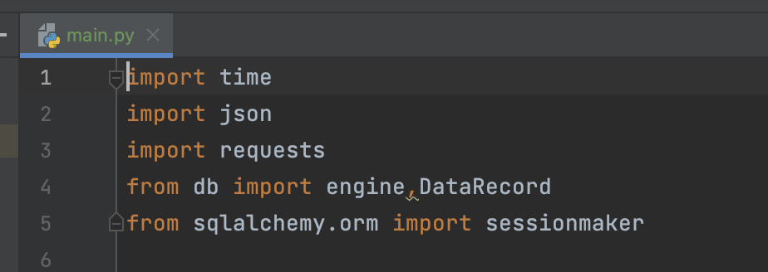
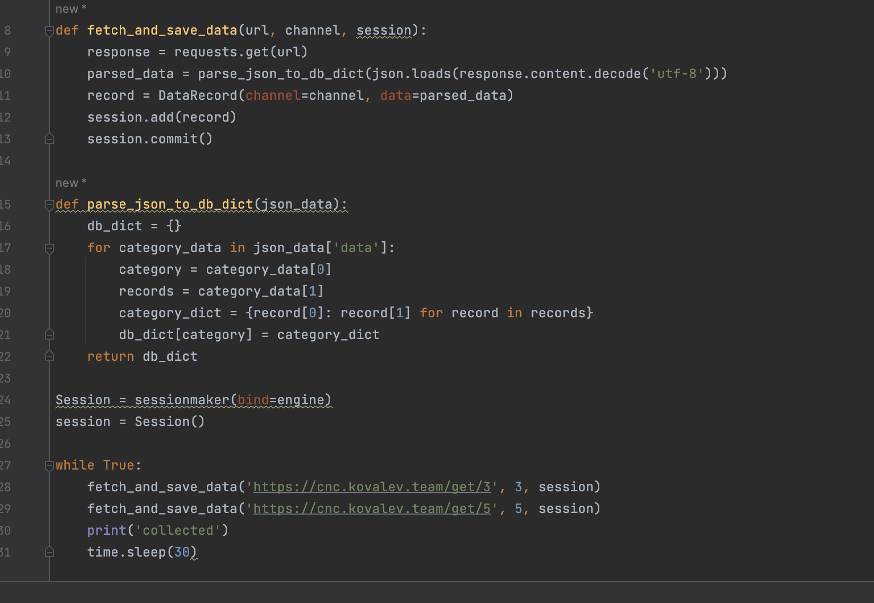
Third step
“Python Script for parsing and loading data”:
Write a code for parsing in Python
Create a config file

Slide 6
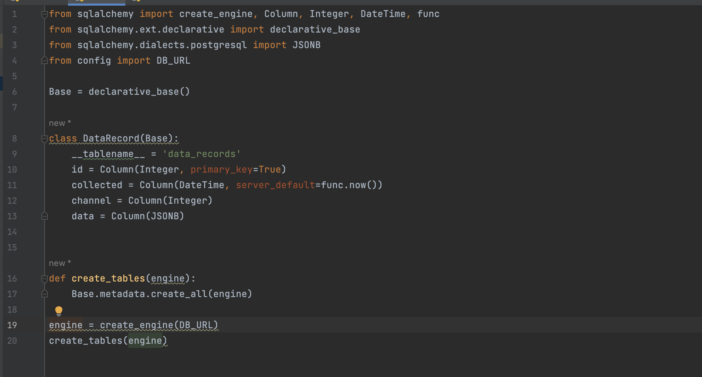
Third step
“Python Script for parsing and loading data”:
Write a code for loading data in Python to DB
Add code to systemd as a service

Slide 7
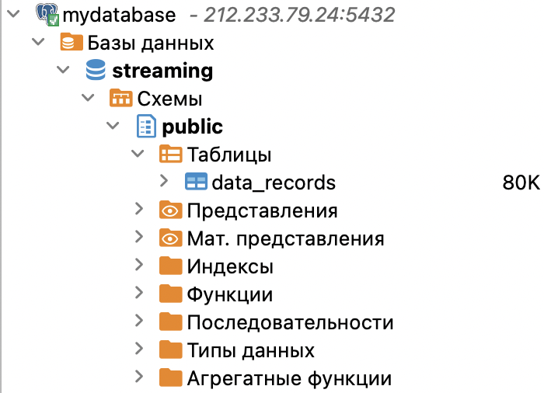
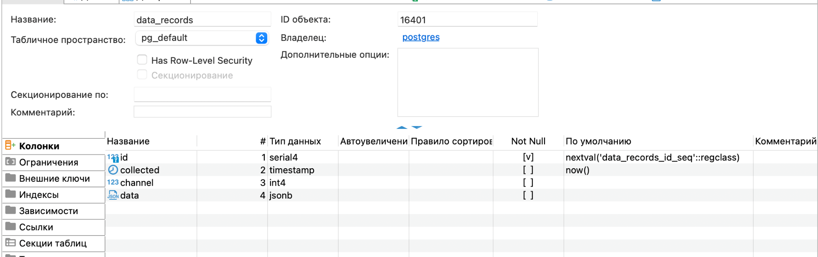
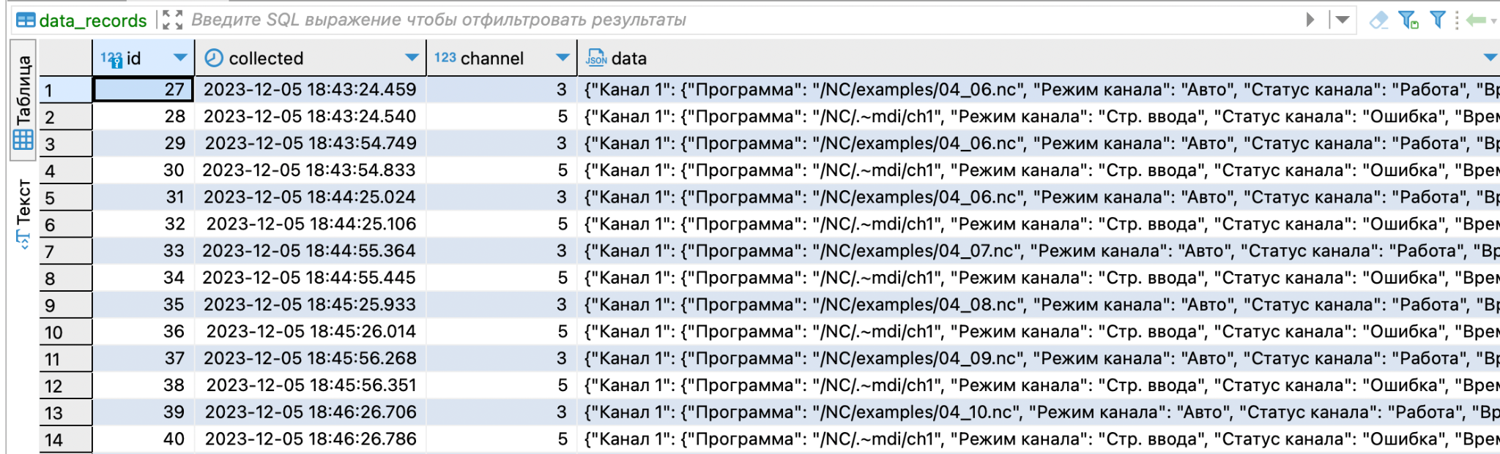
Fourth step
“Checking the correct creating of DB and loaded data:
Check the data in Dbeaver

Slide 8
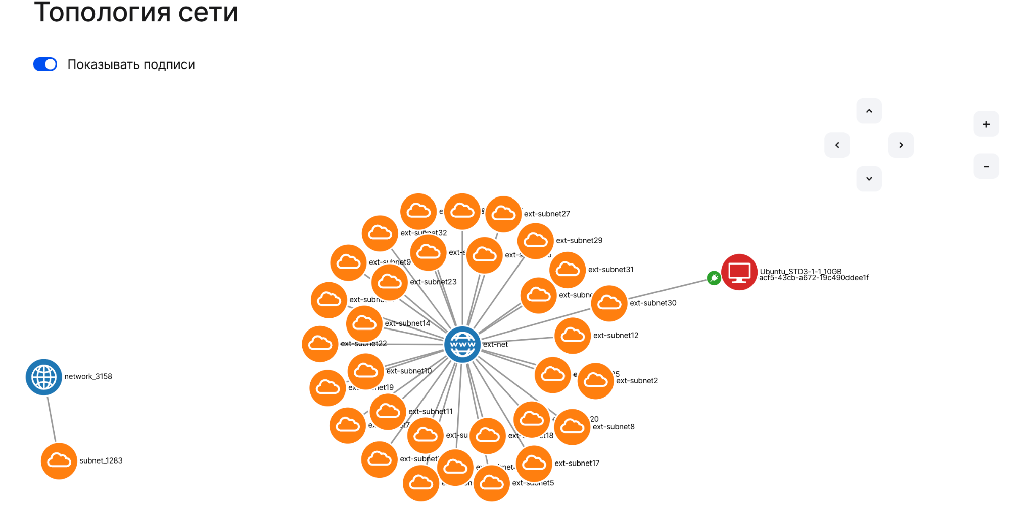

Slide 9
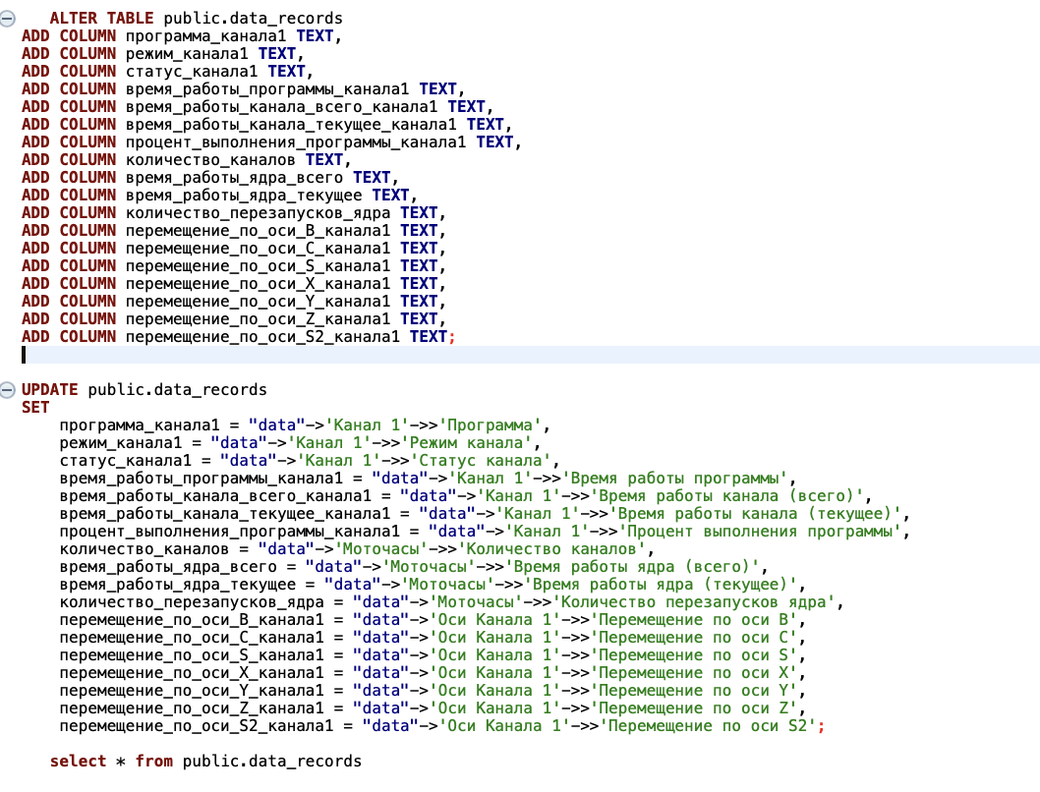
Алина Голубева Марьяна Абдаллах
Preparation data for analysis
Process of splitting JSON data

Slide 10
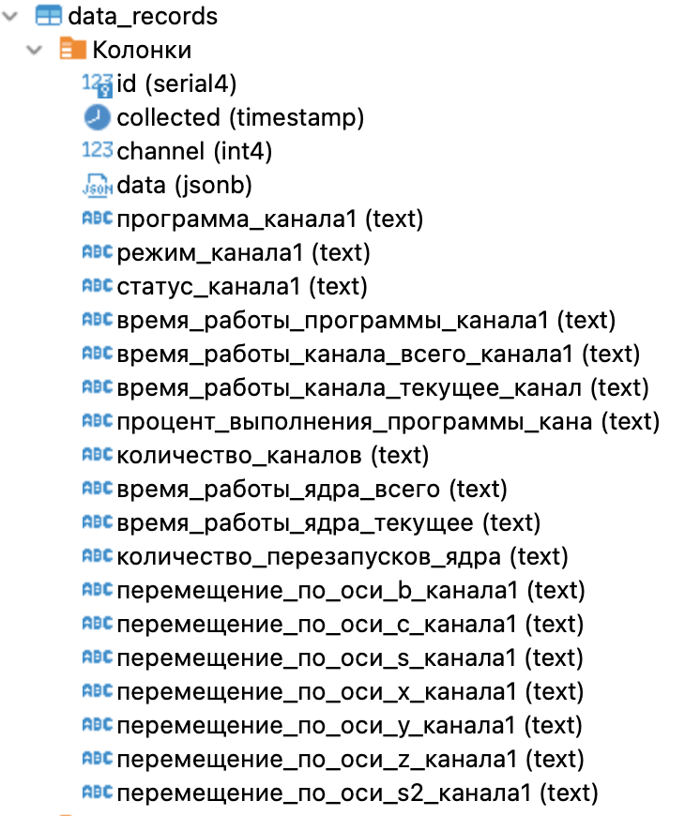
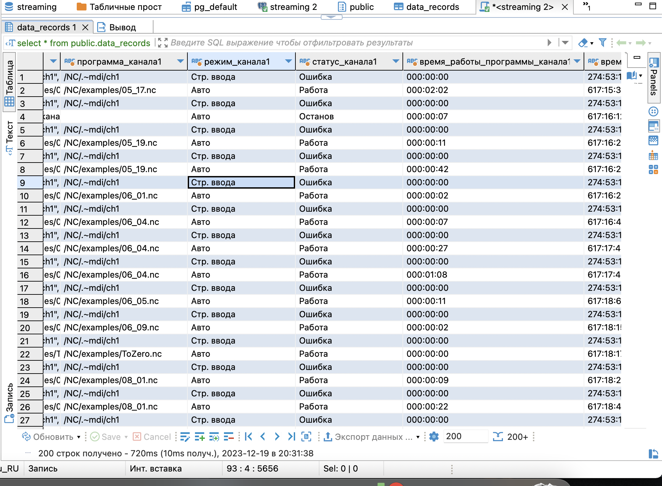
Алина Голубева Марьяна Абдаллах
Разделенные данные
Separated data

Slide 11
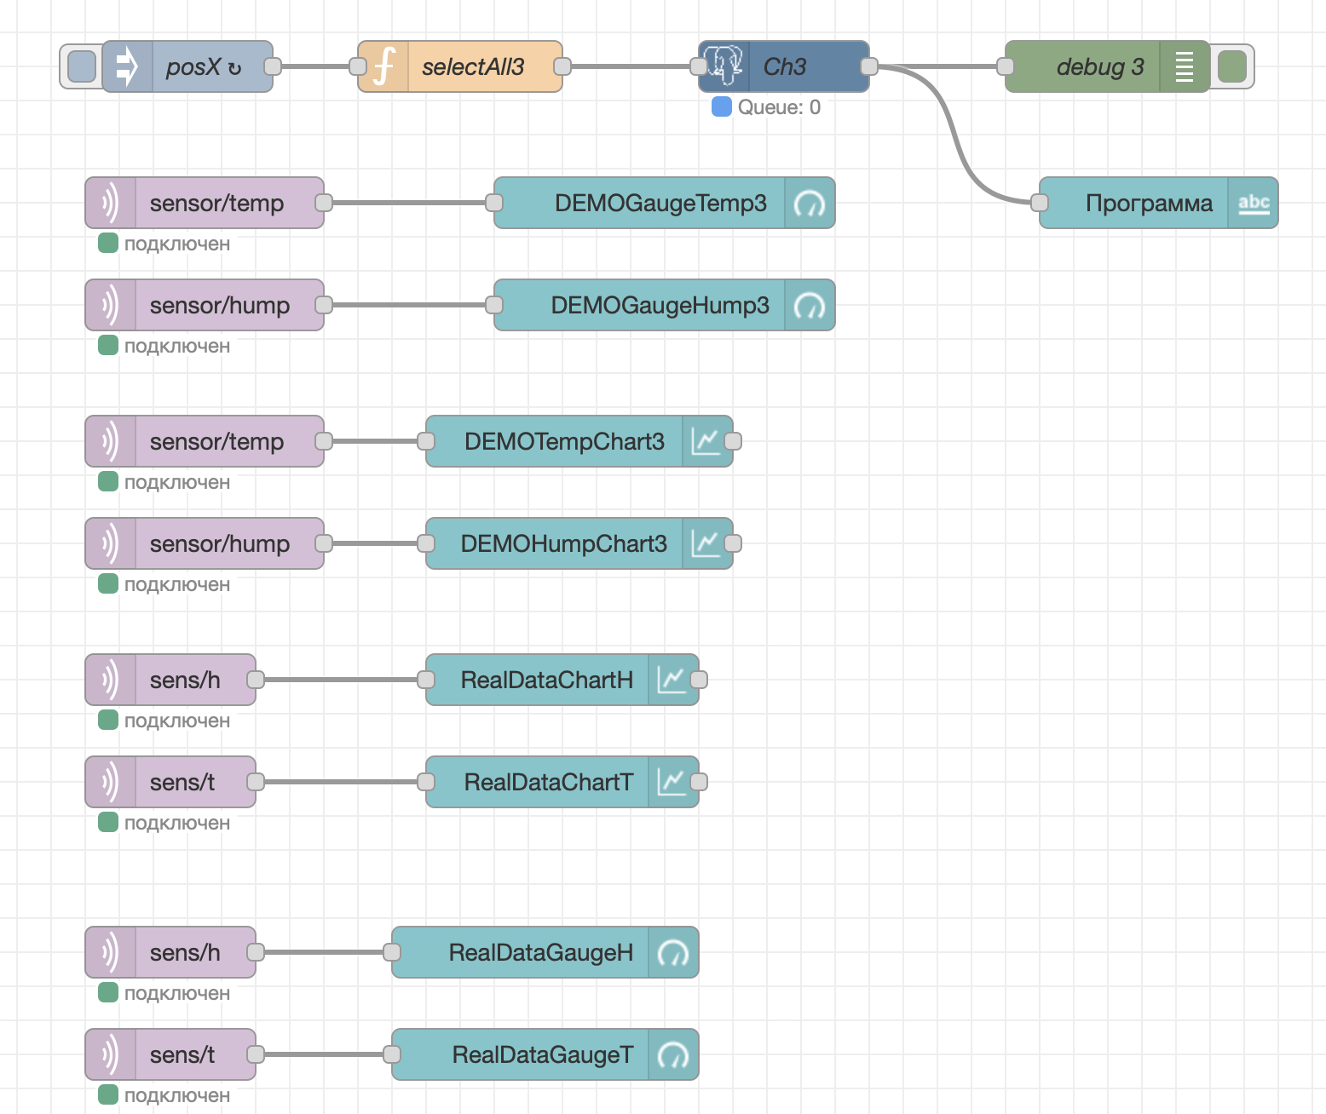
Alina Golubeva
MQTT dashboard Node-red

Slide 12
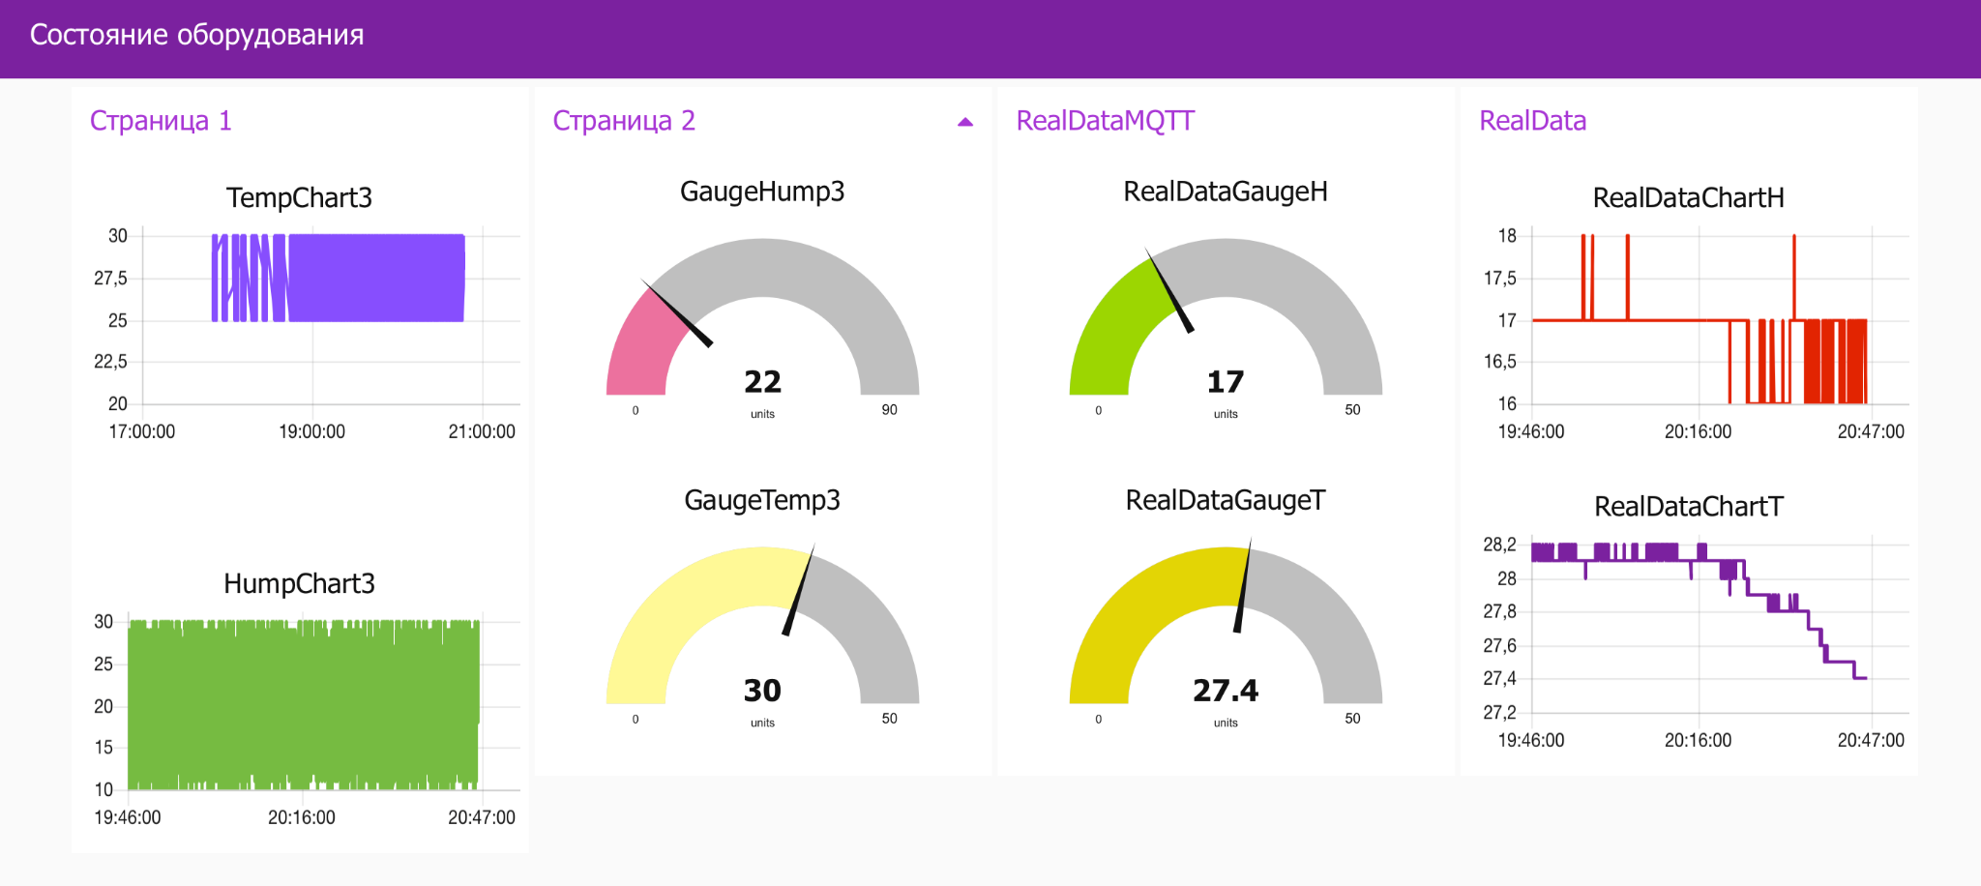
Alina Golubeva
MQTT dashboard Node-red

Slide 13
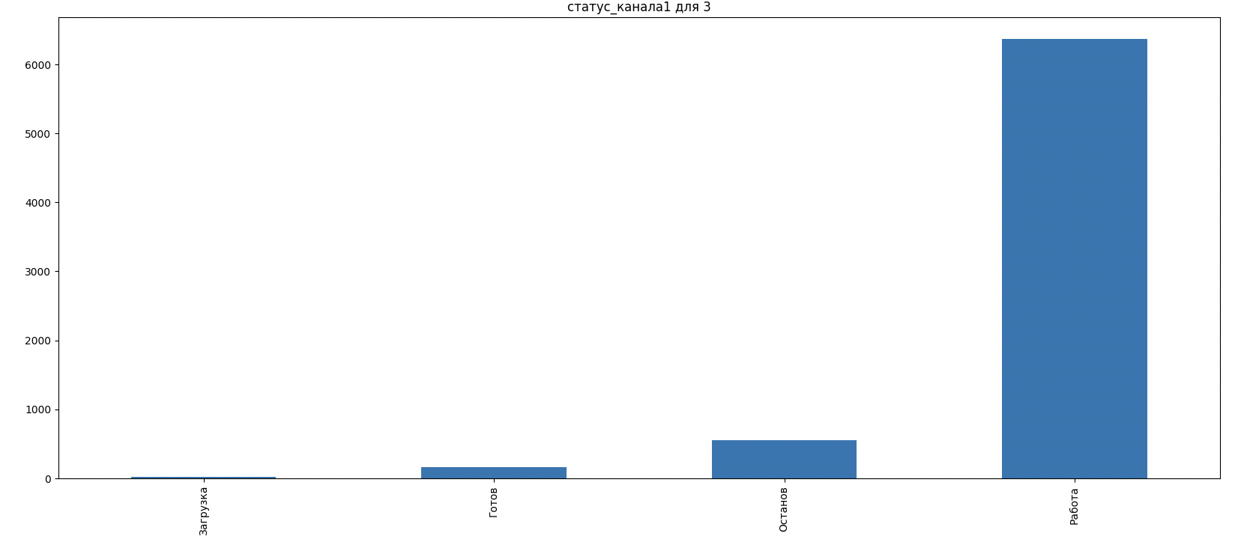
Abdallah Maryanna
Analysis
Channel 3
3.1 Calculate what state (Режим канала) the CNC was in the most time?

Slide 14
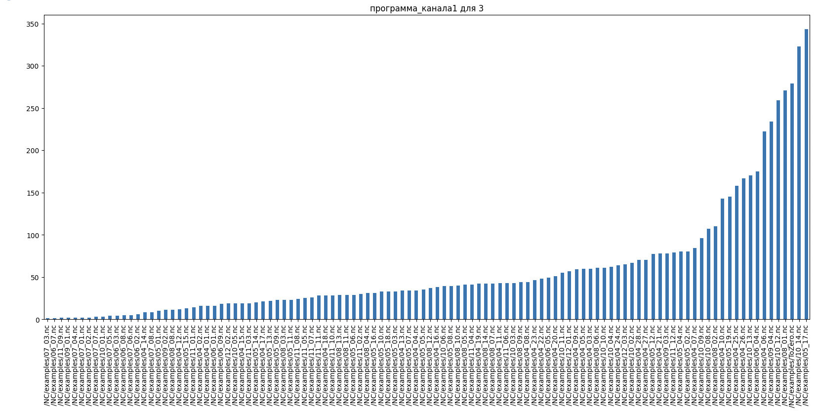
Abdallah Maryanna
Analysis
Channel 3
3.2 Which program (Программа) has been running the most time?

Slide 15
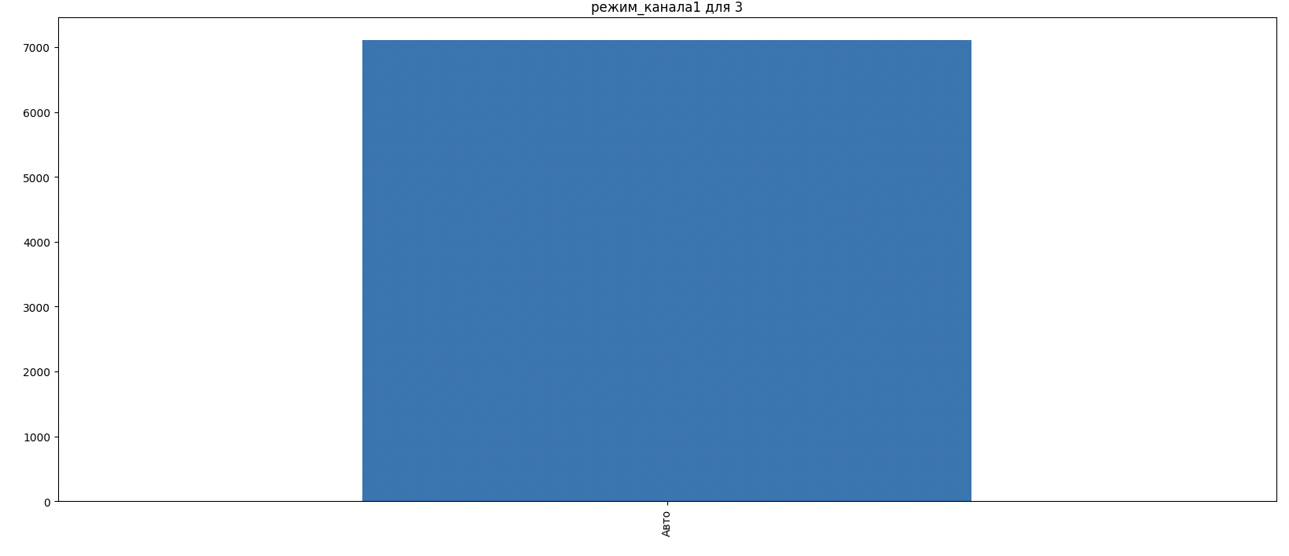
Abdallah Maryanna
Analysis
Channel 3
3.3 Calculate what mode (Режим канала) the CNC was in the most time? (create diagram chart)

Slide 16
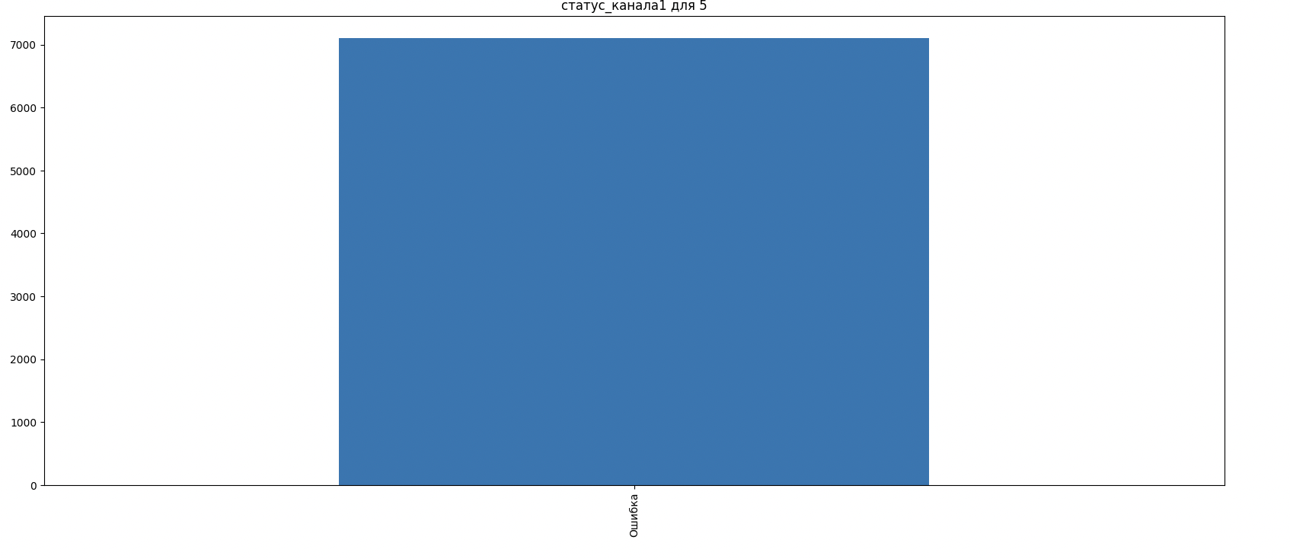
Abdallah Maryanna
Analysis
Channel 5
3.1 Calculate what state (Режим канала) the CNC was in the most time?

Slide 17
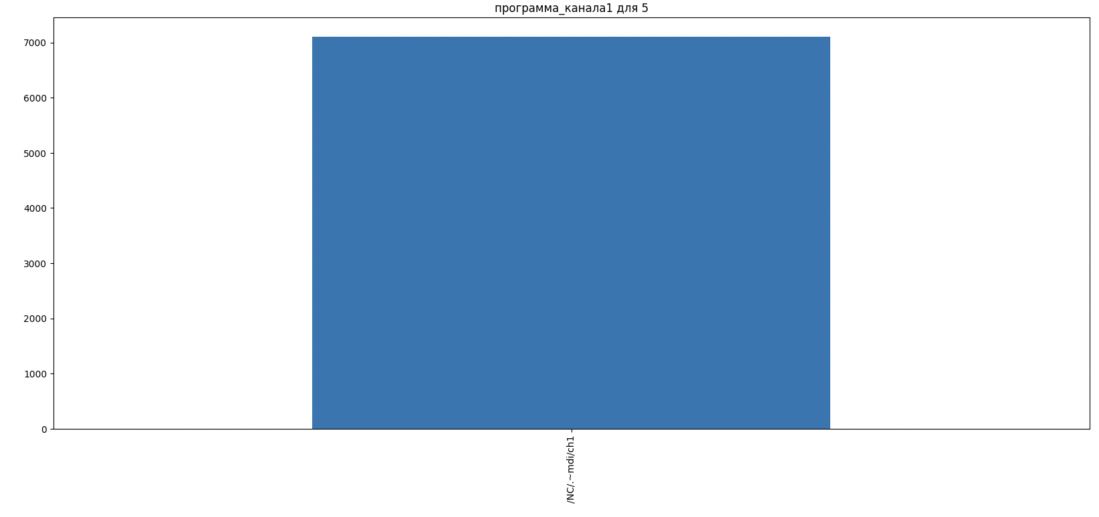
Abdallah Maryanna
Analysis
Channel 5
3.2 Which program (Программа) has been running the most time?

Slide 18
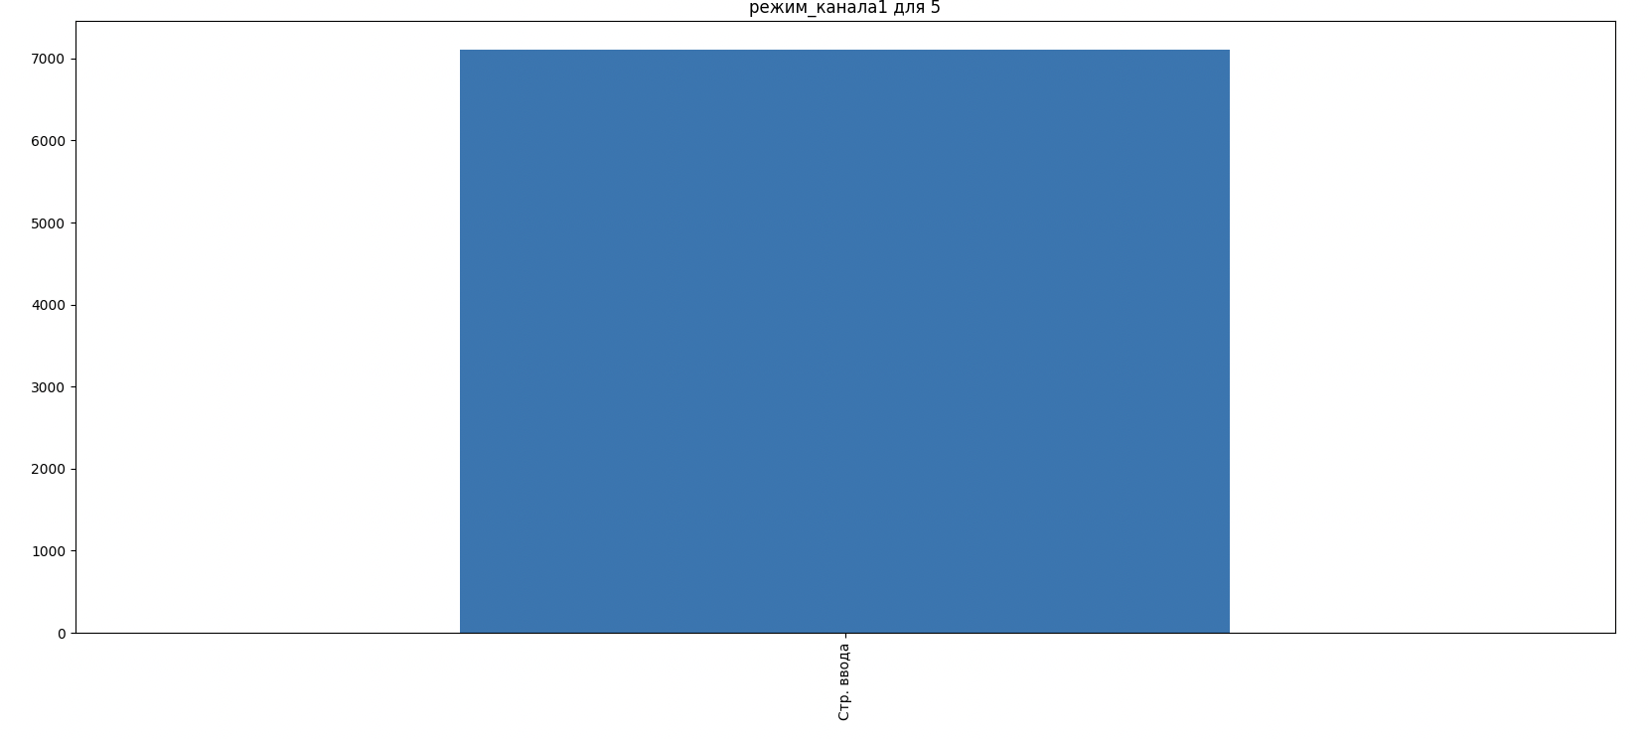
Abdallah Maryanna
Analysis
Channel 5
3.3 Calculate what mode (Режим канала) the CNC was in the most time? (create diagram chart)

Slide 19
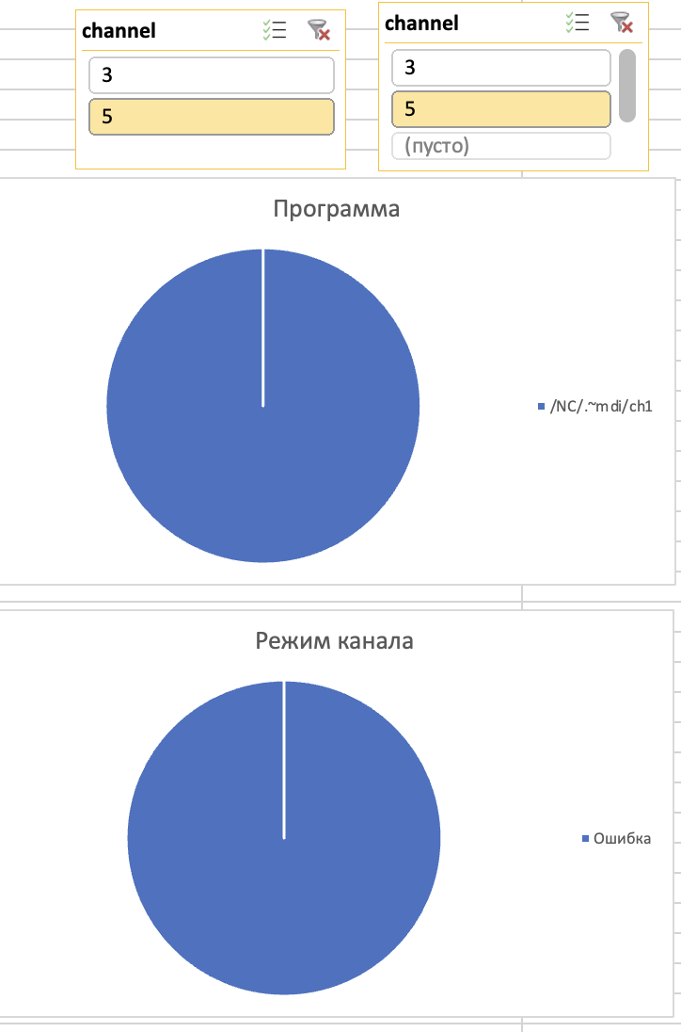
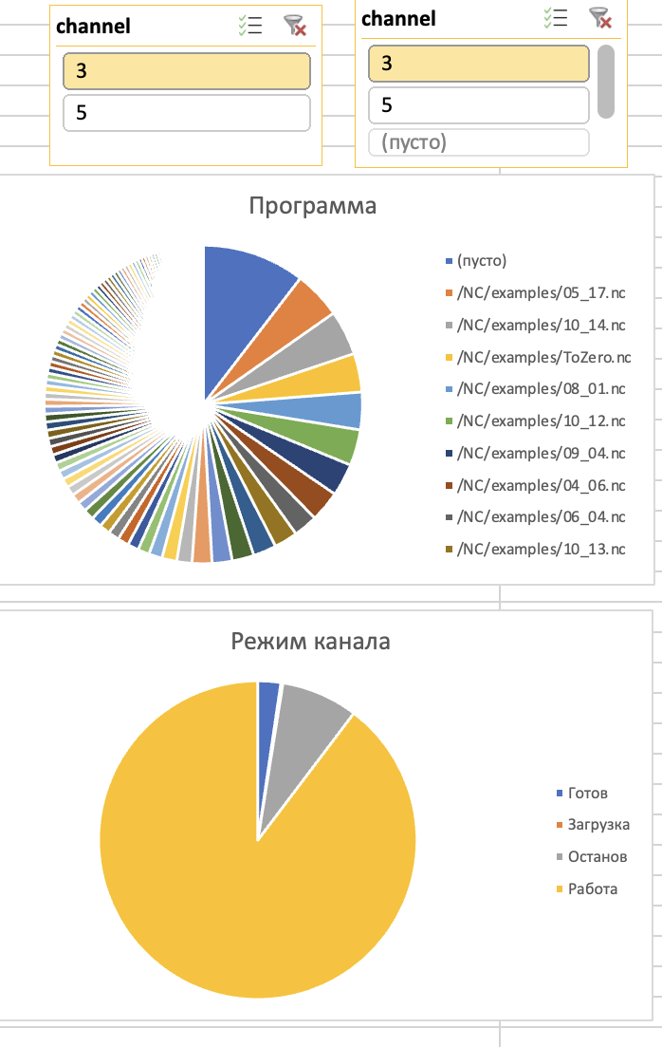
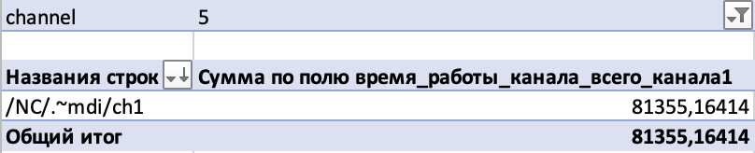
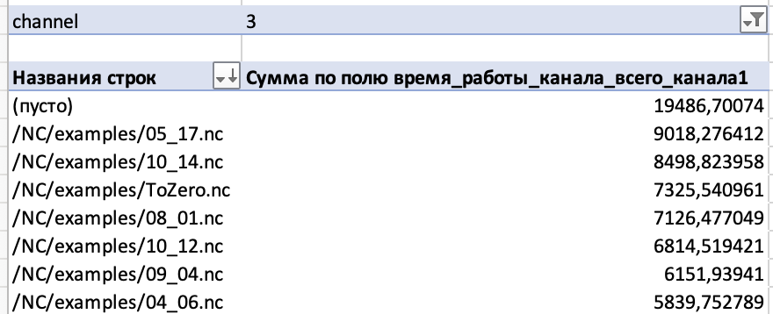
Alina Golubeva
Analysis
3.1 Calculate what state (Режим канала) the CNC was in the most time?
3.2 Which program (Программа) has been running the most time?
3.3 Calculate what mode (Режим канала) the CNC was in the most time?
3.4 Calculate how long the CNC worked (online) and how long it was offline?

Slide 20
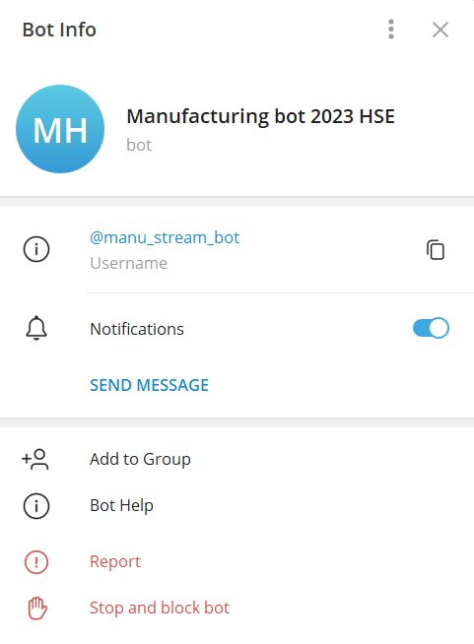
Fifth step
“Create a Telegram bot”:
Manufacturing bot 2023 HSE
@manu_stream_bot

Slide 21
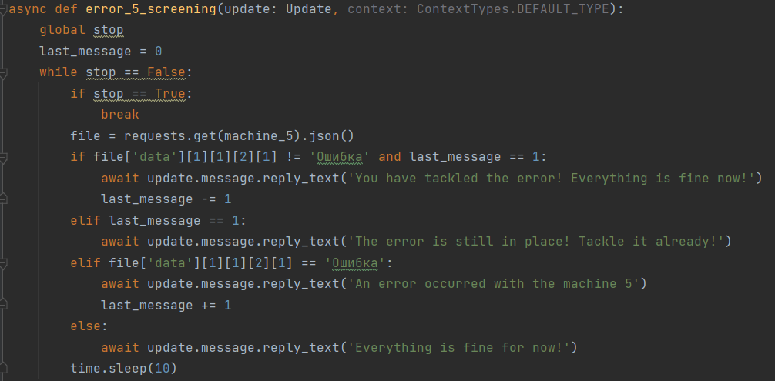
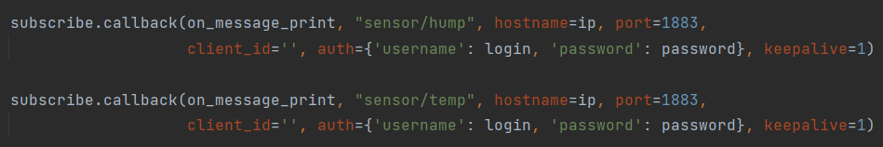
Sixth step
“Make notifications about errors and extreme values from sensors”:
Selecting status from json that are accessed on URLs
Connects to MQTT using paho-mqtt

Slide 22
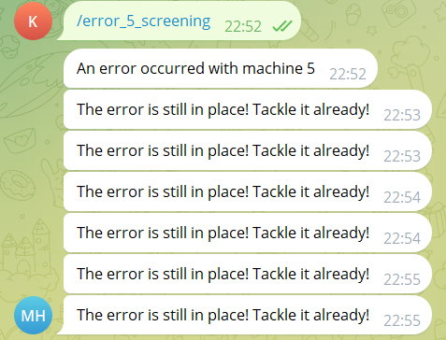
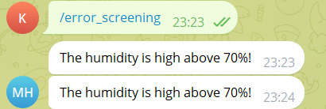
Seventh step
“Receive notification”:
Received some notifications concerning errors
Notified whether there is a rise in humidity or temperature

